Slide 1

Missouri
Final presentation for semester project
Presenters:
Chen Shih, Giwa Haheeb Rilwan, and Phan Thanh-Long

Slide 2

Process of development
Productive tools
Designs
Module structure
Implementations
Demo
Q&A
 | 0 | 1 | 2 | 3 | 4 | 5 | 6
A
B |  |  |  |  |  | O
C | O | O | O | O |  | O
D |  |  |  |  |  | O
E |  |  |  |  |  | O
F |  |  | O |  |  | O
G |  |  | O
H
7 mins
5 mins
8 mins

Slide 3

Process of development
SRS
Document
Main
Structure
Implement
functions
Test
&
Debug
Test
&
Debug
Integration

Slide 4


Productivity Tools
GitHub – version control, file management
Notion – planning meetings, organizing tasks,
record important infomation

Slide 5
Designs
SRS
Document
Main
Structure
- Interactive user interface
- Mistake proofing mechanism
- Sound effects
Test
&
Debug

Slide 6
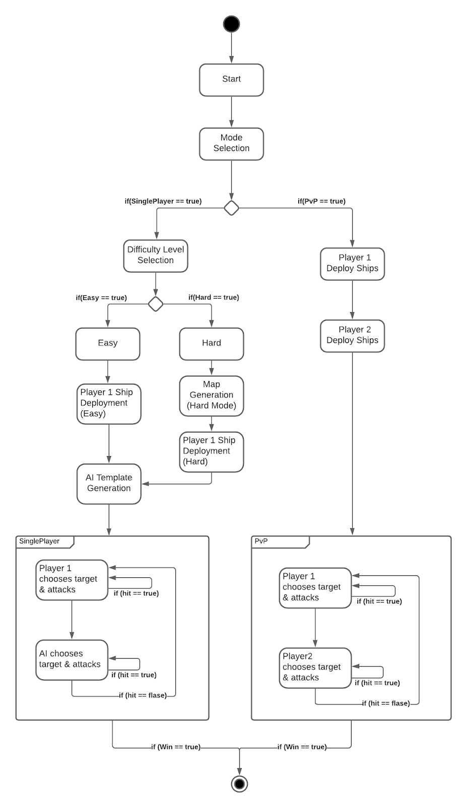
Module Structure
SRS
Document
Main
Structure
Implement
functions
- Modularity
- Independency
- Ease of maintaince & debug
[ Main.c ]
[ Library.h ]
Test
&
Debug
Test
&
Debug
Integration

Slide 7
Implementations
SRS
Document
Main
Structure
Implement
functions
- Check_key()
- Choose_Coordinate()
- Deployment()
- PvP_battle()
- AI_battle()
- Generate_map()

Slide 8
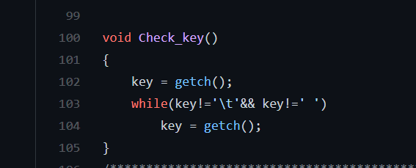
Implementations
- Check_key()
SRS
Document
Main
Structure
Implement
functions
The Check_key() function consists of a while loop and a getch() function

Slide 9
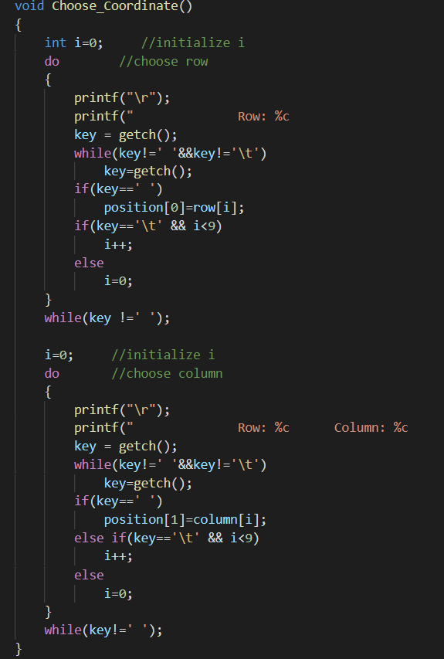
Implementations
- Choose_Coordinate() & Choose_Direction()
SRS
Document
Main
Structure
Implement
functions
Choose_Coordinate()
Choose_Direction()
This function enables players to input letters
(A-J) for rows, numbers from (0-9) for
columns.
With this function, players are enabled to
choose the heading direction of their ships .

Slide 10
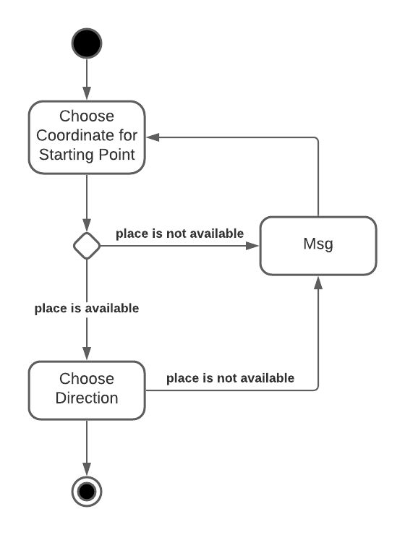
Implementations
- Deployment()
SRS
Document
Main
Structure
Implement
functions
Each ship type has its own code for ship deployment, and they are executed sequentially in the following order:
Carrier (OOOOO ship)
Battleship (OOOO ship)
Cruiser (OOO ship)
Destroyer (OO ship).

Slide 11
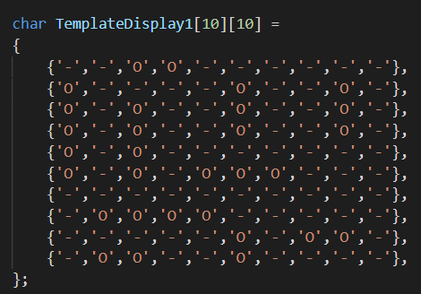
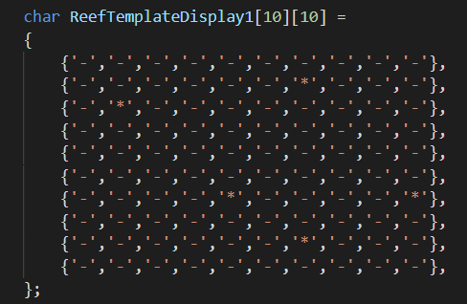

Implementations
- Generate_map()
2 arrays for each template, similar to deployment().
SRS
Document
Main
Structure
Implement
functions
SRS
Document
Main
Structure
5 Ship Templates for Computer:
TemplateGridX[10][10]
TemplateDisplayX[10][10]
5 Obstacles Maps for Hard Mode:
ReefTemplateGridX[10][10]
ReefTemplateDisplayX[10][10]
Fig. char TemplateDisplay1
Fig. char ReefTemplateDisplay1

Slide 12
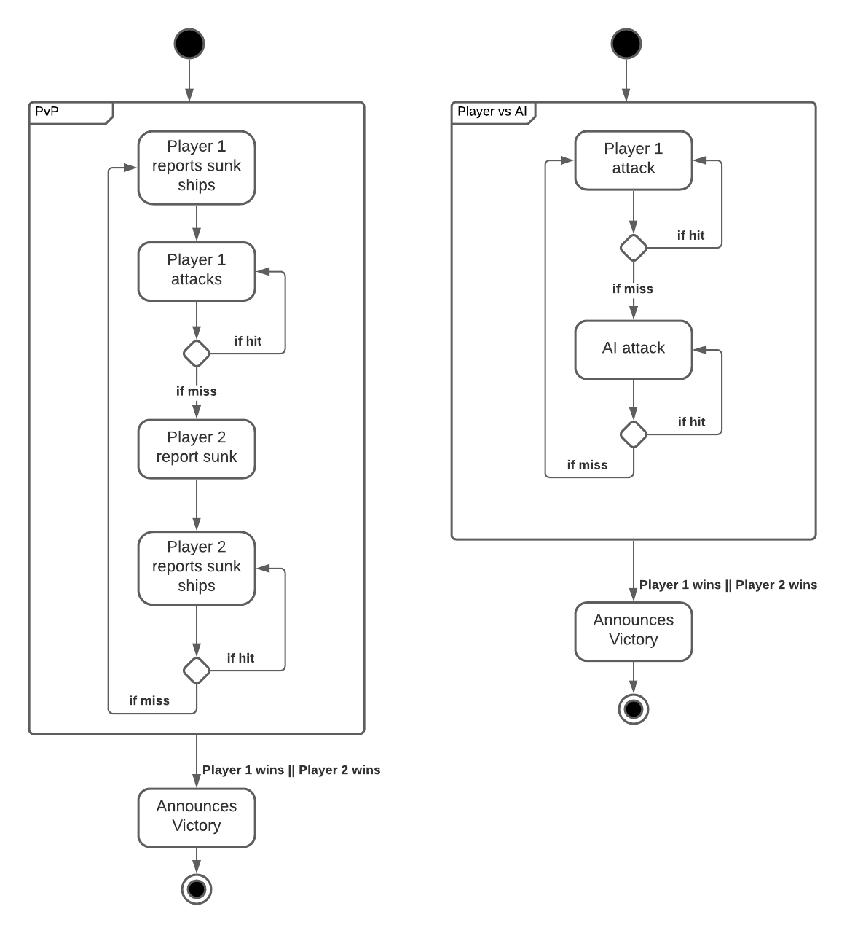
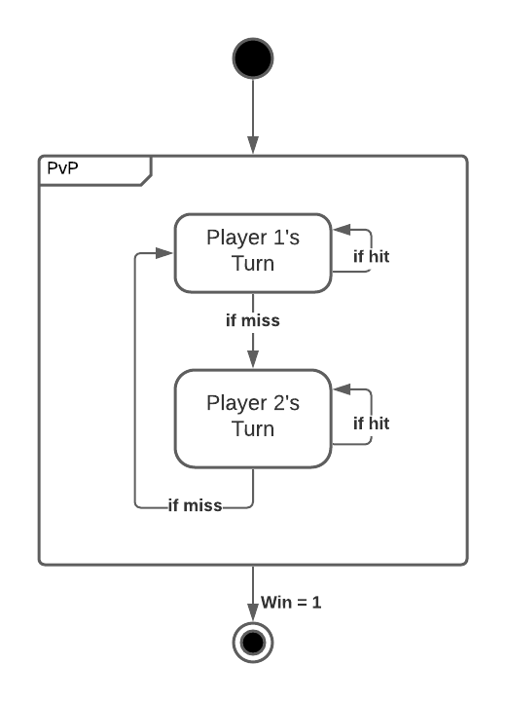
Implementations
- PvP_battle()
Fig. State Machine Diagram of PvP_Battle()
Fig. Activity Diagram of PvP_Battle() compared to Player vs AI Mode

Slide 13
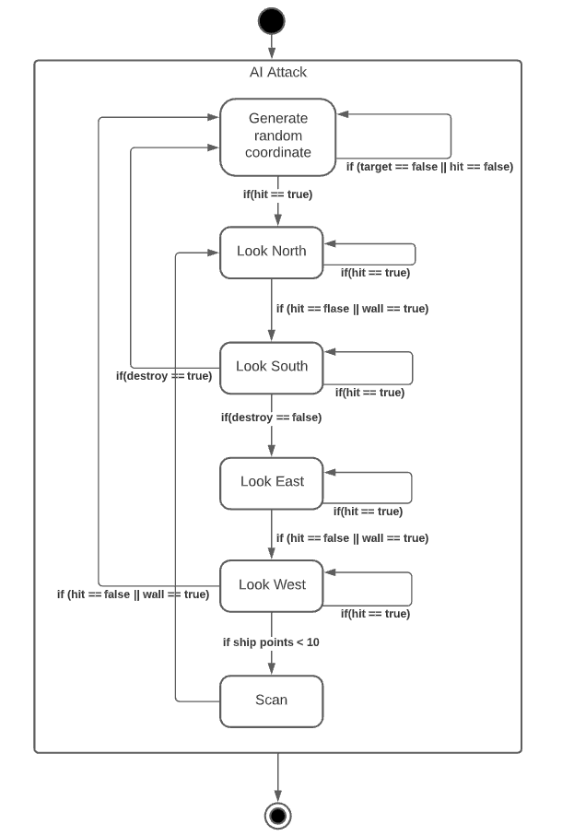
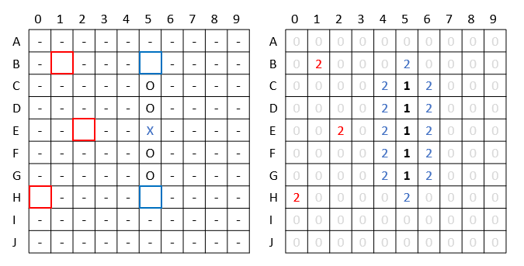
Implementations
- AI_battle()
Usage of smart_grid
Advance searching :
1. Random mode
2. Scanning mode

Slide 14
Demo

Slide 15


Slide 16
Q & A

